Slide 1
No-Added-Sugar Event
June 12, 2024
Dasman Diabetes Institute

Slide 2
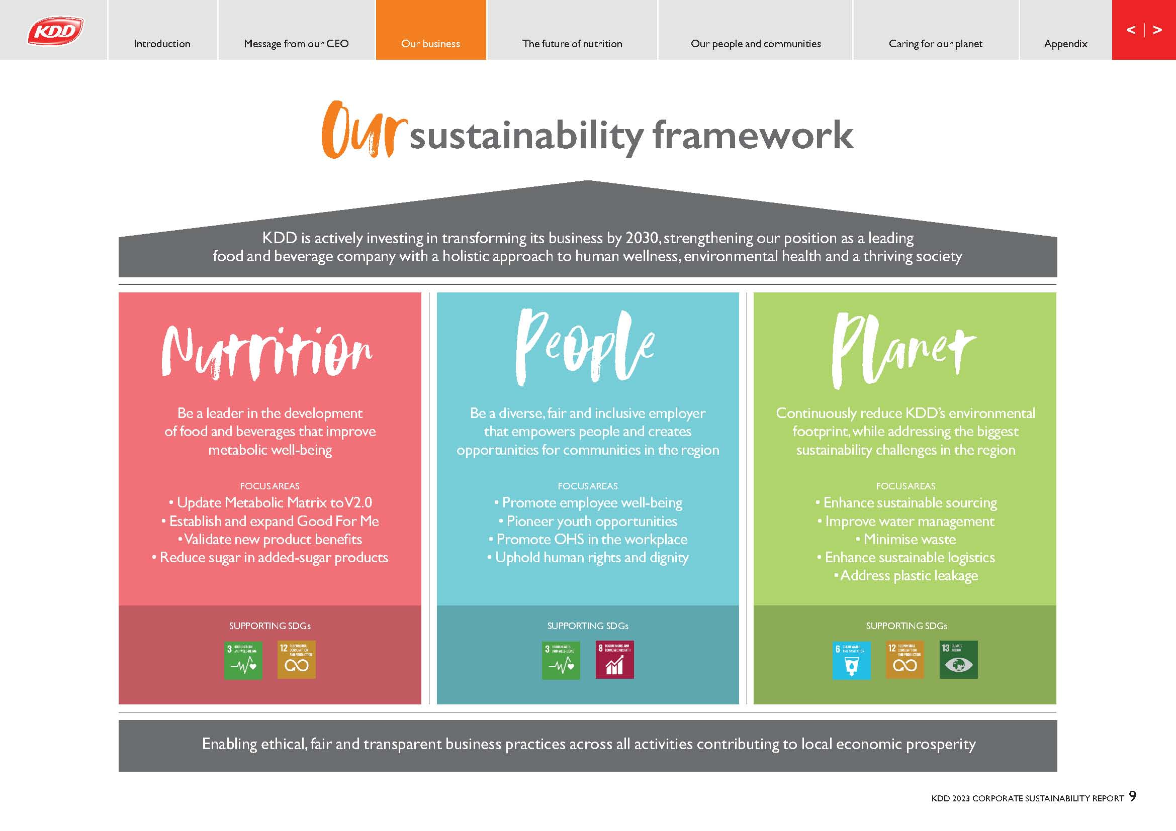
Pure Wholesome Goodness
KDD’s commitment is more than just a slogan, we back it with science and quantifiable metrics.
KDD’s Sustainability Framework Supports
Five United Nations
Sustainable Development Goals (SDGs)
“If you don’t measure it, it doesn’t count.”
Source: https://www.kddc.com/about-kdd/sustainability-commitment/

Slide 3
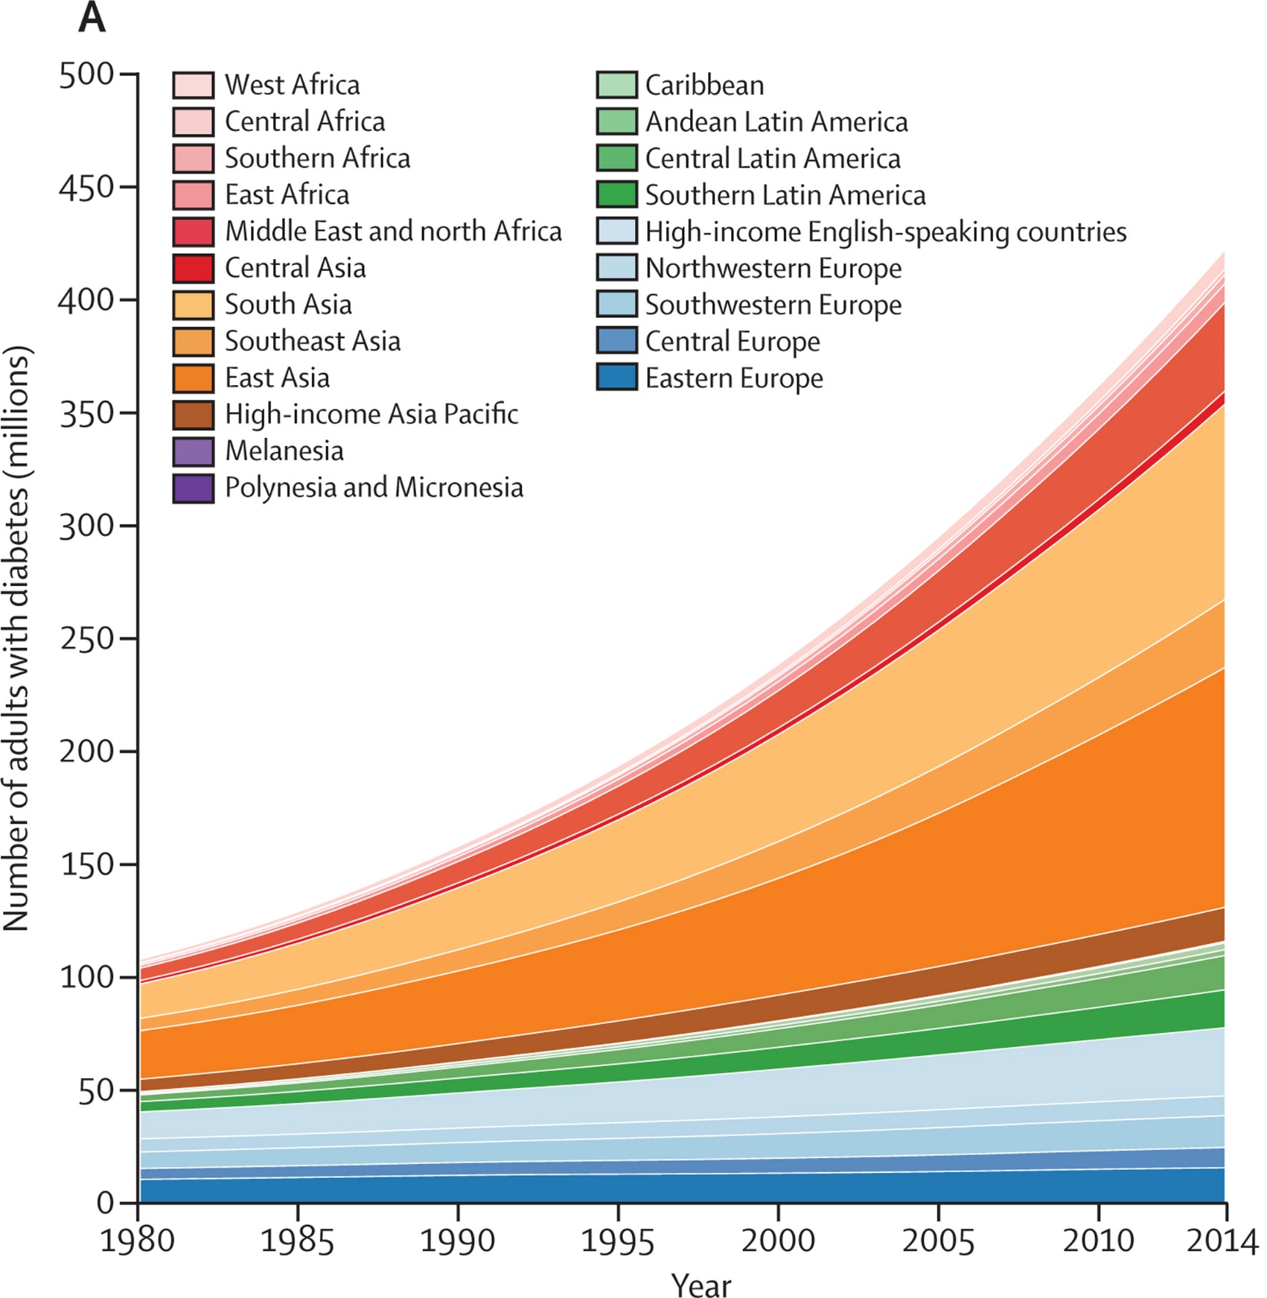
We need a food system that supports health
The last four decades have seen rates of metabolic disease increase exponentially.
In the 1980s, Type 2 diabetes was referred to as “geriatric diabetes” as it existed mainly in the elderly population.
The last four decades has seen a progressive increase in the prevalence of “early onset type 2 diabetes mellitus”
12.6% of women in Kuwait are affected by Gestational Diabetes Mellitus. A child’s risk of developing type 2 diabetes at a young age increases when the mother has diabetes while pregnant, depending on the type of diabetes.
Sources: Early onset type 2 diabetes: risk factors, clinical impact and management, Therapeutic Advances in Chronic Disease.
Worldwide trends in diabetes since 1980: a pooled analysis of 751 population-based studies with 4·4 million participants. The Lancet.
Prevalence, Risk Factors, and Fetomaternal Outcomes of Gestational Diabetes Mellitus in Kuwait: A Cross-Sectional Study, Journal of Diabetes Research.
Adults with Diabetes
Notes:
https://diabetes.ca/about-diabetes/stories/risk-of-childhood-type-2-diabetes-may-begin-in-the-womb

Slide 4
Kuwait Health Demands Change
34 to 37%
7.66%
Prevalence of metabolic syndrome in Kuwait
Kuwait Healthcare spending on Non-alcoholic Fatty Liver disease (NAFLD)
80%
>20%
Prevalence of diabetes mellitus in Kuwait
Kuwait population with at least one chronic disease.
Notes:
Eighty percent of the population has at least one chronic disease and 50 % percent of those problems can be treated, but are not known to their personal doctors. (2) (PDF) Healthcare of Aging Population of Kuwait. Available from: https://www.researchgate.net/publication/257770795_Healthcare_of_Aging_Population_of_Kuwait [accessed Jun 04 2024].
In Kuwait, the prevalence of metabolic syndrome is 37.7% in women and 34.2% in men [17], higher than the 20–25% worldwide estimate of metabolic syndrome in adults Source:
2012 Study https://www.ncbi.nlm.nih.gov/pmc/articles/PMC3386600/
2024 Study (cites 2012 study data) https://www.ncbi.nlm.nih.gov/pmc/articles/PMC11013774/

Slide 5
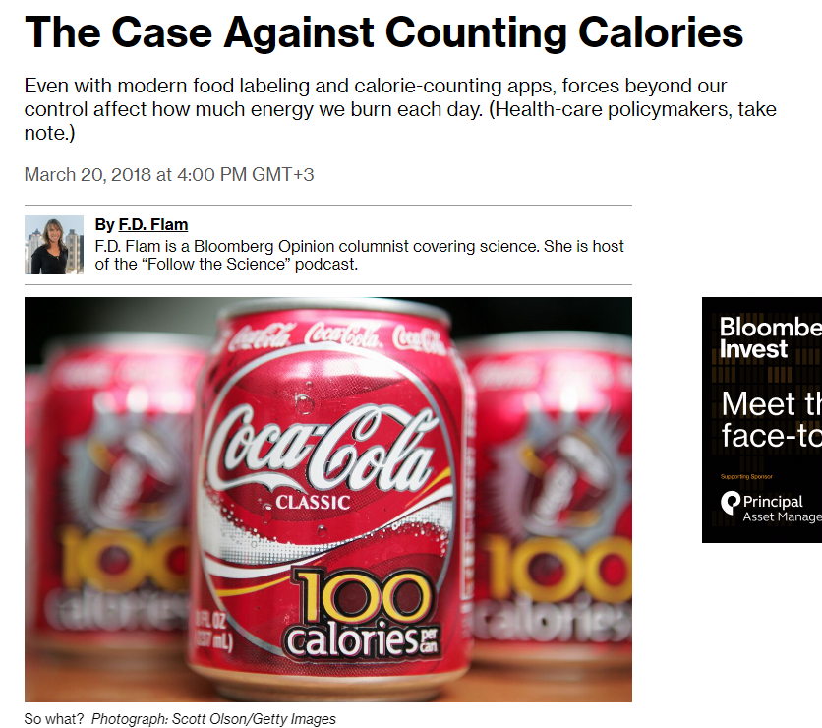
Shifting the Focus to Metabolic Dysfunction and its Root Causes
Focusing exclusively on counting calories and on the symptom of obesity hasn’t worked.
In fact, there are more thin people with metabolic disease than overweight people.
A growing body of science now is focused on the primary cause of metabolic dysregulation: diet and the quality and composition of the foods therein.
Sources: Association between dietary patterns and metabolic syndrome in individuals with normal weight: a cross-sectional study, Nutrition Journal.
Is the calorie concept a real solution to the obesity epidemic? Global Health Action.
Metabolically healthy obese and metabolic syndrome of the lean: the importance of diet quality. Nutrition Journal.

Slide 6
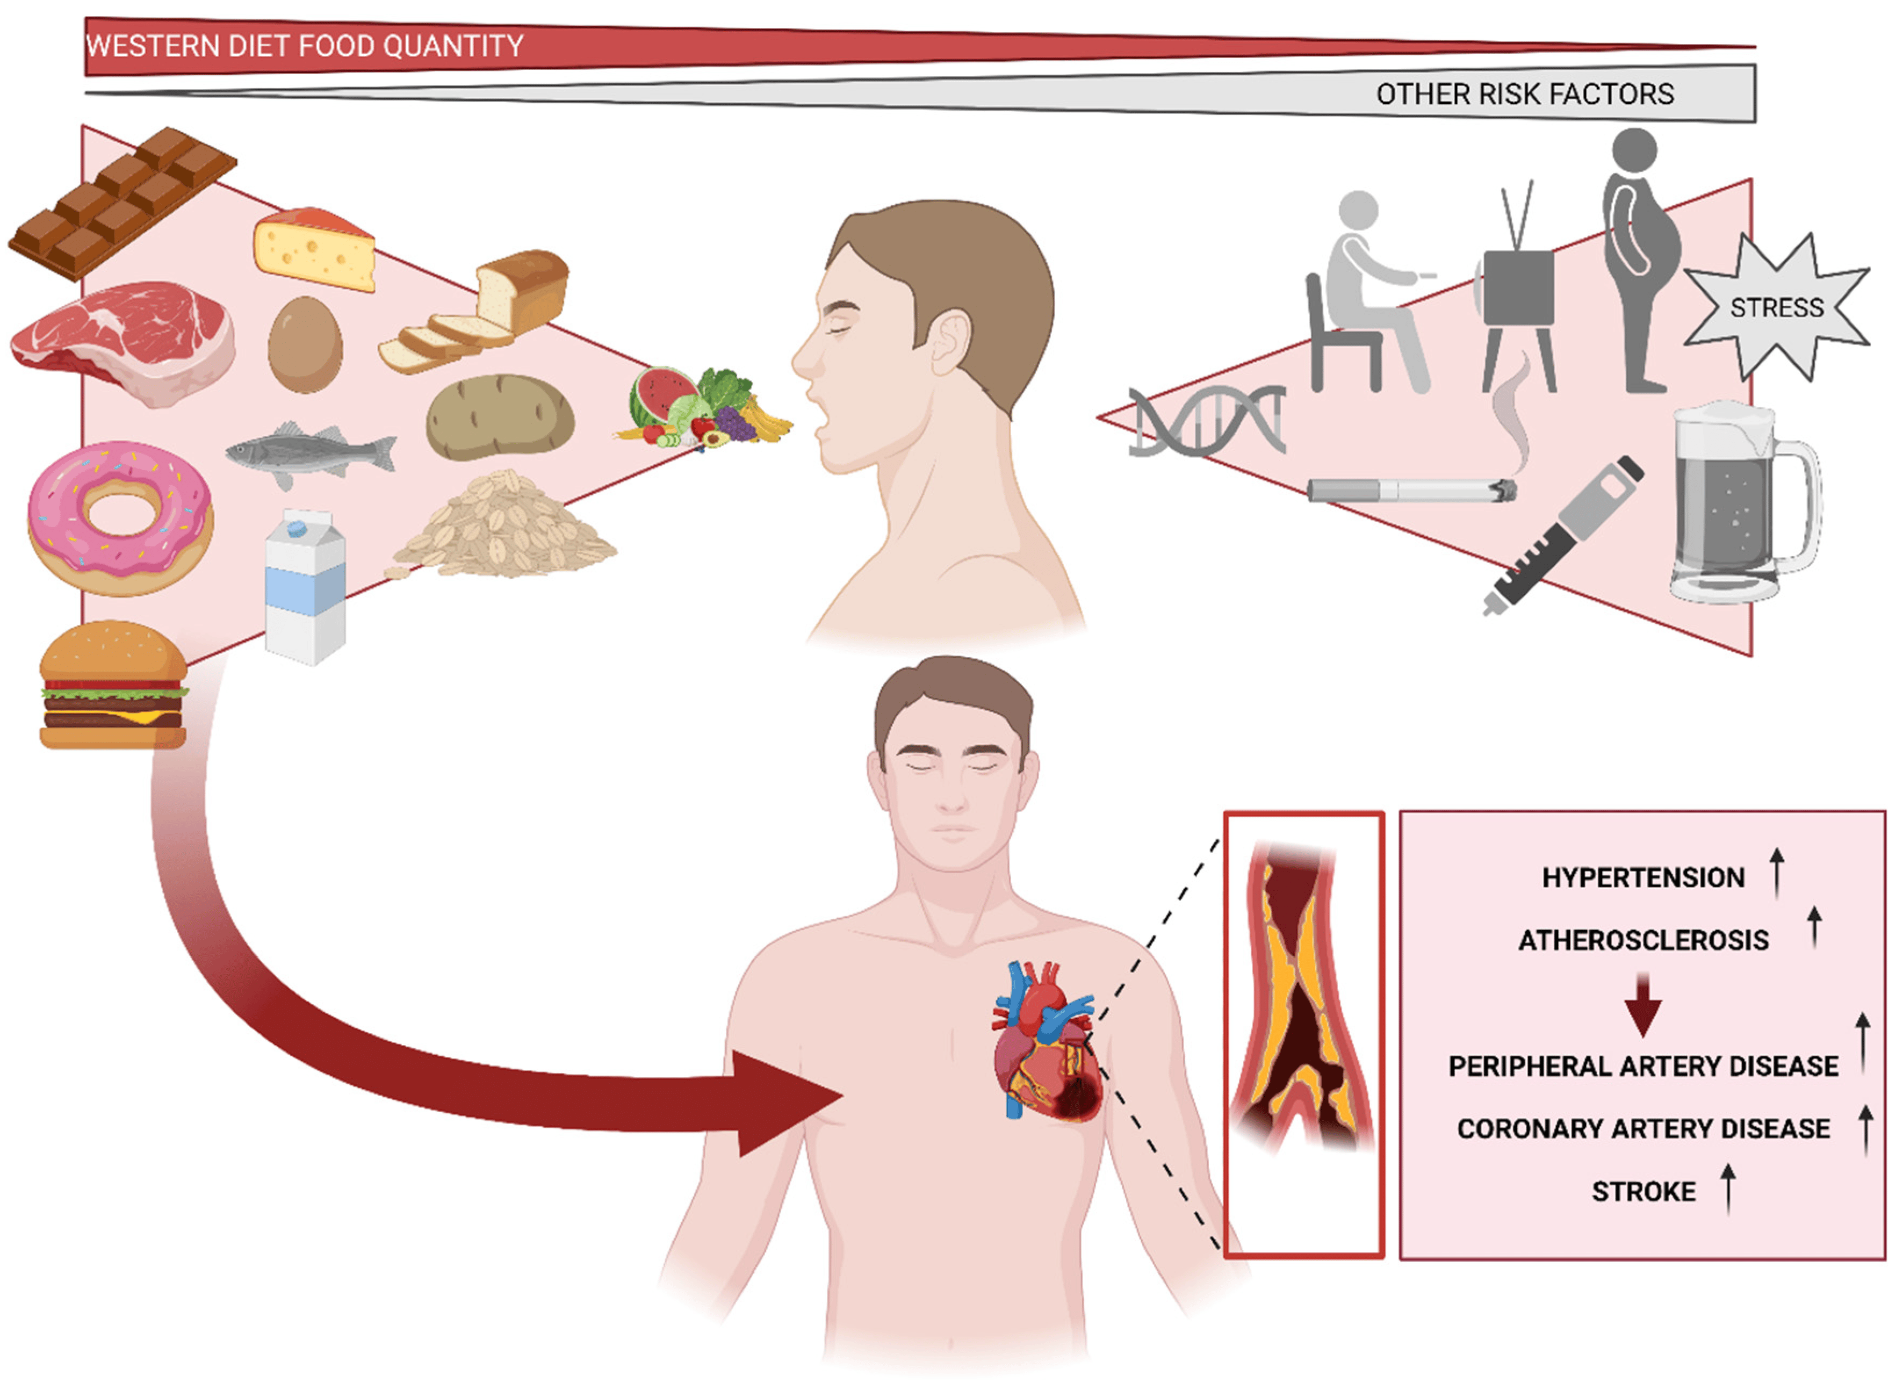
Metabolic syndrome is a complex disease that correlates with obesity, but nonetheless appears to be distinct from it
The “Western diet” is a major factor, which has now been adopted globally due to palatability and price.
The fact that children can develop metabolic syndrome suggests that while obesity and aging contribute to the syndrome, it is unlikely that they are initiating factors.
Source: What is metabolic syndrome, and why are children getting it? Annals of the New York Academy of Sciences.

Slide 7
The problem is not simply “obesity”
Notes:
30% of the population are obese
Of these, 80% are obese and sick, 20% are healthy
70% of the population is normal weight
Of these, 40% are sick, 60% are healthy
There are more sick (normal weight) people than sick (obese) people

Slide 8
We are not what we eat, we are what we metabolize.
You can be fat in the inside, fat on the outside, or both.
Fatty liver disease is the driver of metabolic syndrome and it is not dependent on obesity.
Obese
Low Liver Fat = 2.6%“Fat Healthy”
Obese
High Liver Fat = 24%
“Fat Sick”
Thin
High Liver Fat = 23%
“Thin Sick”
Sources: Excess body fat in obese and normal-weight subjects, Cambridge University Press & Non-Alcoholic Fatty Liver Disease and its Link to Chronic Illnesses, Unraveling the Hidden Epidemic, Robert H. Lustig
Notes:
Source: Excess body fat in obese and normal-weight subjects, Cambridge University Press.

Slide 9
Metabolic health is the north star of nutrition
Linking nutritious food, metabolism and health is essential to preventing diet-related diseases and the burdensome financial burdens they foster.
Fundamental and structural changes are needed in the way the food and beverage industry approaches nutrition, adopting metabolic health as the “North Star.”
“Farm to fork” thinking leaves out metabolism and must shift to scientific framing: “molecule to mitochondria”
“All roads lead to metabolism.”
- Robert Lustig, MD, MSL
Notes:
catalyzing food system change with a science-based approach that the food & beverage industry can adopt and scale globally.
A "metabolic reset" provides rich opportunities for cross-sector collaboration and alignment where food meets health.
Chronic disease driven by processed food provided the backdrop for COVID-19 to spiral out of control.

Slide 10
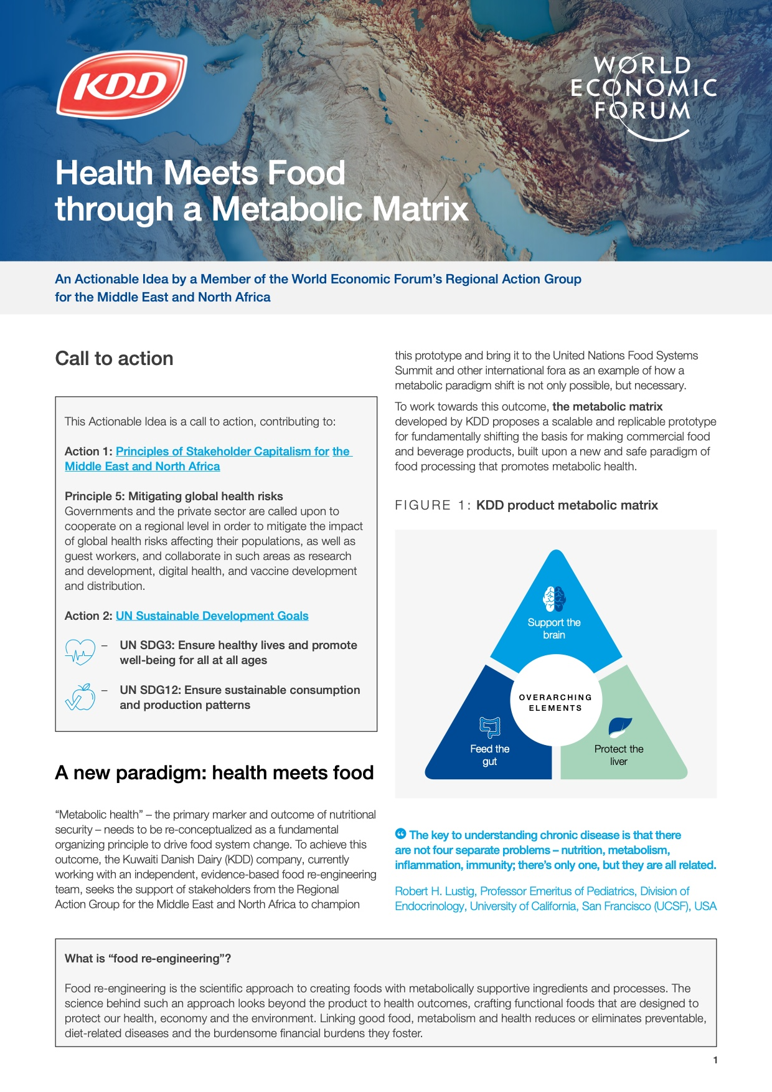
KDD Calls for a Metabolic Reset in the MENA Region
In 2021, Sir Mohammad Jaafar, Chairman and CEO of KDD, posted an article and paper WEF platform introducing an “actionable idea” of a “metabolic matrix” and a “metabolic reset.” KDD commissioned the development of the metabolic matrix by a team of independent scientists in 2020.
Food meets health: How a new approach to metabolic health could tackle chronic disease
Health Meets Food through a Metabolic Matrix
What are these concepts and why are they being presented?
Why is KDD, a leading food and beverage company based in the middle east, serving as a champion for these ideas?

Slide 11
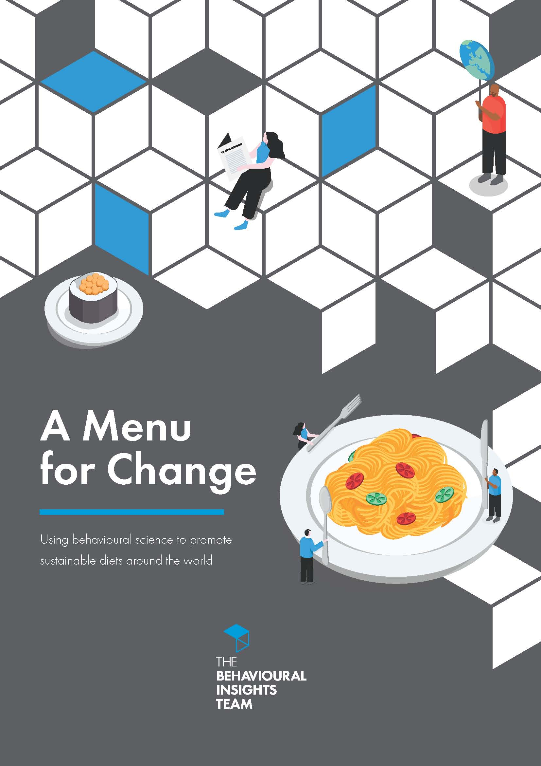
Food System Change: Where do we begin?
Provide more healthy choices.
“Diet interventions that seek to alter the ‘external’ setting, or choice environment, tend to be more effective than those that target our ‘internal’ motivations.”
Sources:
Which Healthy Eating Nudges Work Best? A Meta-Analysis of Field Experiments. Marketing Science
Informing versus nudging in environmental policy. Journal of Consumer Policy.
A Menu for Change: Using behavioural science to promote sustainable diets around the world. Behavioural Insights Team (BIT).

Slide 12
Value to be created and shared…
“The net benefits of achieving a food system transformation are worth 5 to 10 trillion USD a year, equivalent to between 4 and 8 percent of global GDP in 2020.”
Source: The Economics of the Food System Transformation, Food System Economics Commission.

Slide 13
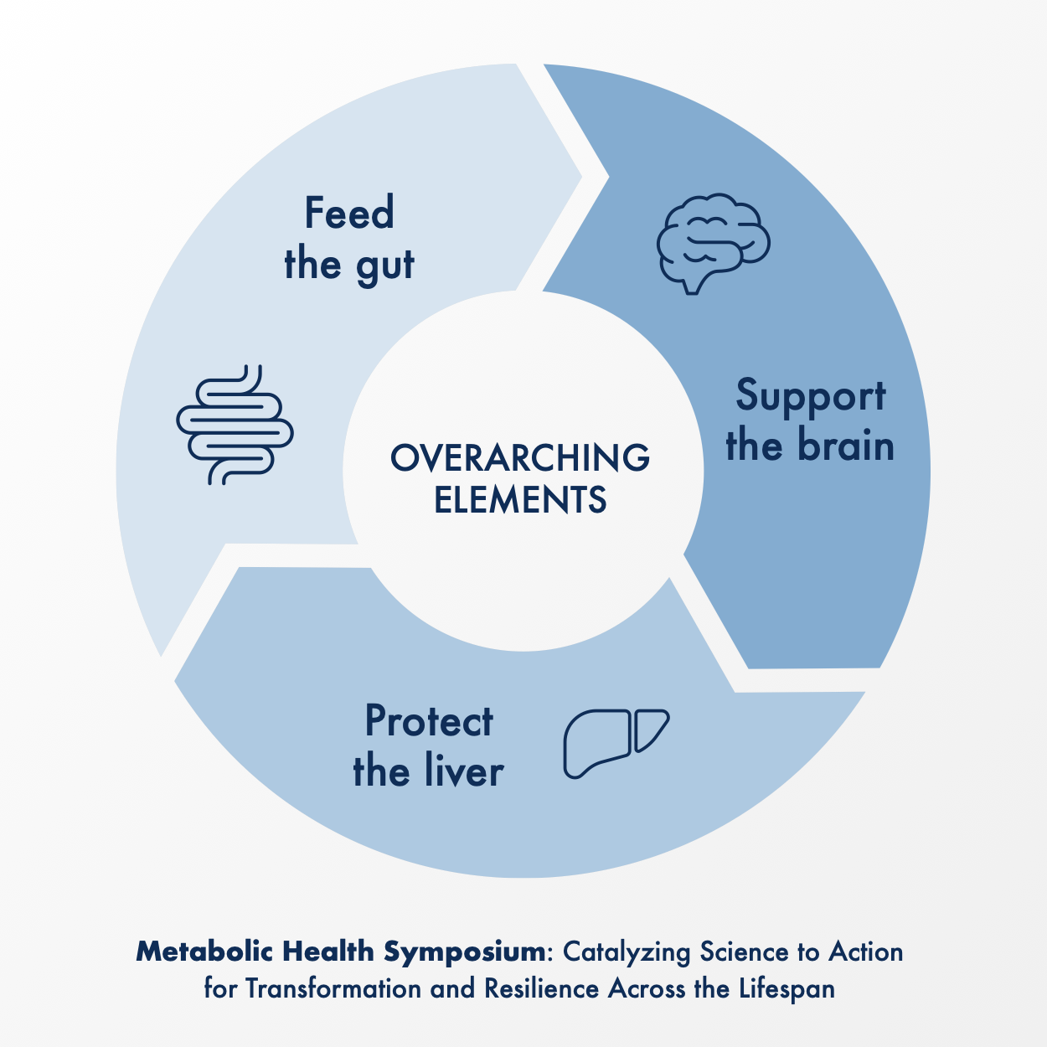
The Metabolic Matrix: A scientific framework that supports metabolic health & nutrition in multiple sectors, including healthcare
Catalyzing Science to Action for Transformation and Resilience Across the Lifespan
Inspired by the metabolic matrix model, Swedish Healthcare system supporting over 100,000 health care providers, including management of Kuwait Hospital has offered three international CME symposiums on metabolic health and nutrition.
A weak focus on metabolism has limited nutrition science as well as the food and beverage industry while chronic, diet related, disease climbs out of control.
A science-based approach to reengineering foods and beverages has the potential to transform our metabolic health.
Notes:
Inspired by the metabolic matrix model, Swedish Hospital, part of the larger Providence health care system supporting over 100,000 health care providers, and the manager of Kuwait Hospital is Offered three international CME symposiums on metabolic health and nutrition.
https://metabolicmatrix.info/education/

Slide 14
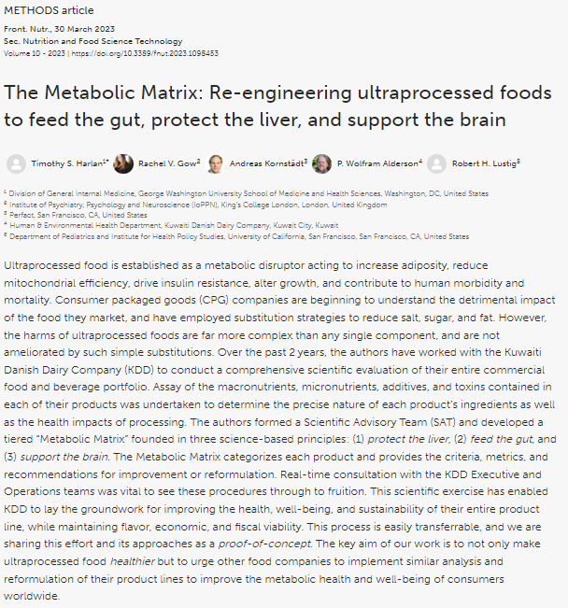
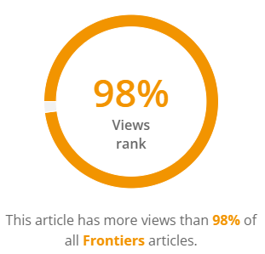
Peer Reviewed Methods Paper Frontiers in Nutrition
Metabolic Matrix Methods Paper is receiving more views than 98% of all other papers on the Frontiers in Nutrition platform and is in the top 5% of all research outputs scored by Altmetric.
Source: The Metabolic Matrix: Re-engineering ultraprocessed foods to feed the gut, protect the liver, and support the Brain. Frontiers in Nutrition.
Notes:
Paper is receiving more views than 98% of all other papers on the Frontiers in Nutrition platform and is in the top 5% of all research outputs scored by Altmetric/

Slide 15
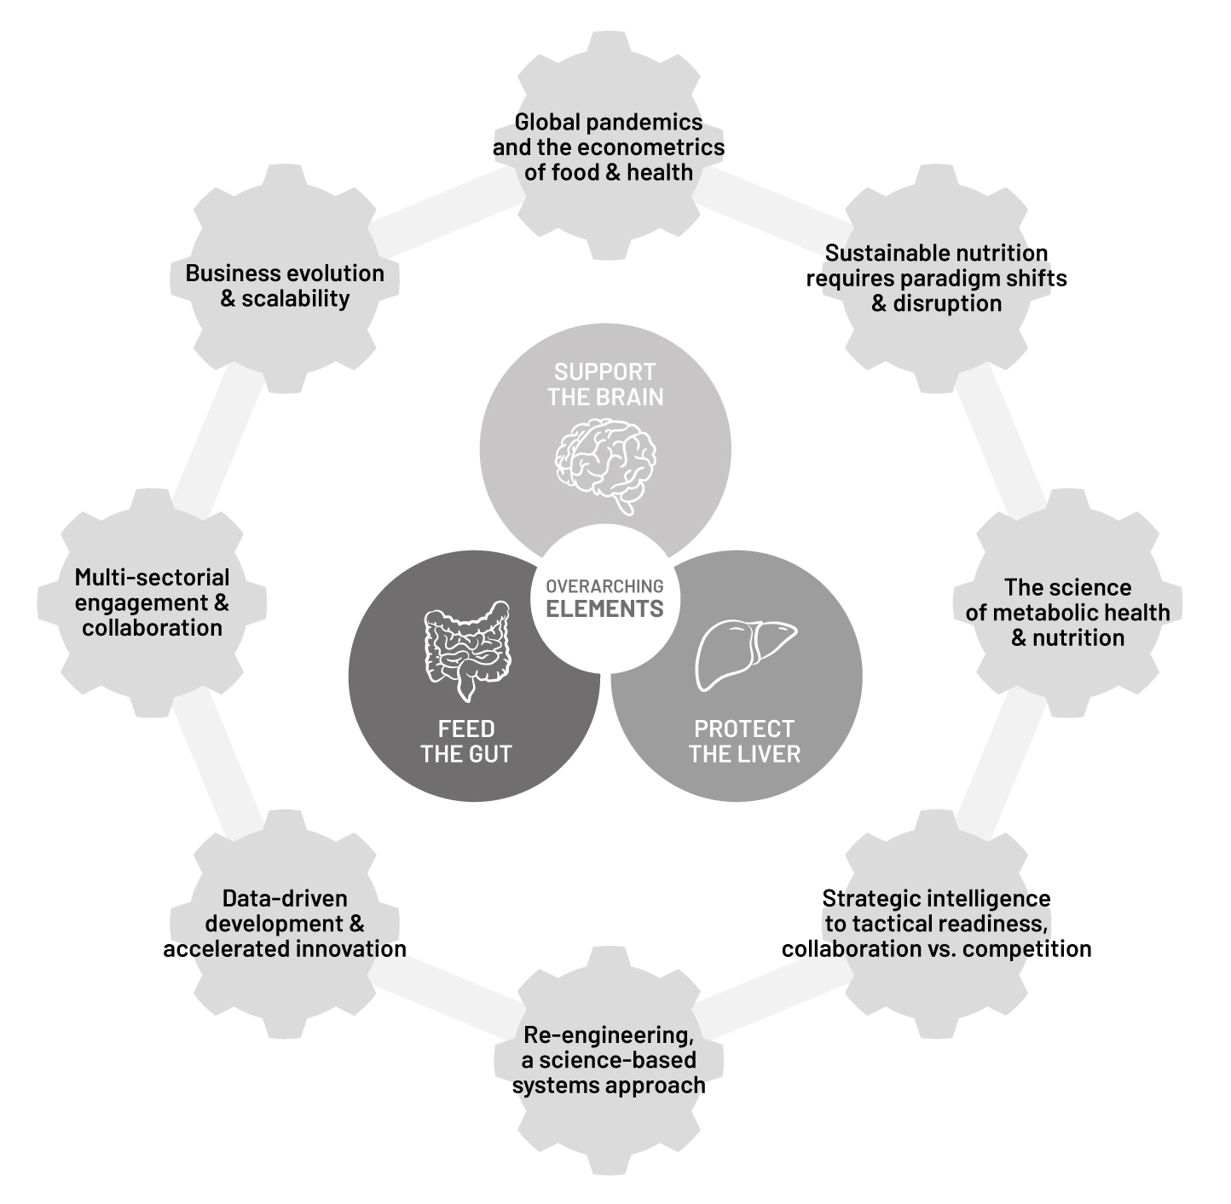
Metabolic Matrix and the Gears of Food System Change
Pandemics and Econometrics
Sustainable Nutrition
Science of Metabolic Health & Nutrition
Strategic Intelligence & Tactical Readiness
Reengineering – Systems Approach
Data Driven Development & Accelerated Innovation
Multi-Sectoral Engagement & Collaboration
Business Evolution & Scalability
Source: How the new future of nutrition puts holistic health first, World Economic Forum:
Notes:
A science-based framework for understanding and applying metabolic health & nutrition that can transform the way we think about formulating foods and beverages.
The matrix is built upon the understanding that nutrition doesn’t exist in a vacuum and that all foods and beverages are ultimately metabolized in the human body.
The metabolic matrix was born out of an industry desire to forge a new level of food system change, based on current scientific evidence.
KDD, a leading food and beverage company in the MENA region, commissioned an independent scientific group of advisors to develop a new approach that linked metabolic health and nutrition.
A year of intensive work resulted in the development of the metabolic matrix model.
From the beginning, KDD sought to share the metabolic matrix model, and to invite collaboration, input, and critiques, to assure that the model will ultimately be useful other interests, recognizing that for true food system change to occur, systemic solutions, versus proprietary solutions are needed.
Pandemics and Econometrics
Sustainable Nutrition
Science of Metabolic Health & Nutrition
Strategic Intelligence & Tactical Readiness
Reengineering – Systems Approach
Data Driven Development & Accelerated Innovation
Multi-Sectoral Engagement & Collaboration
Business Evolution & Scalability

Slide 16
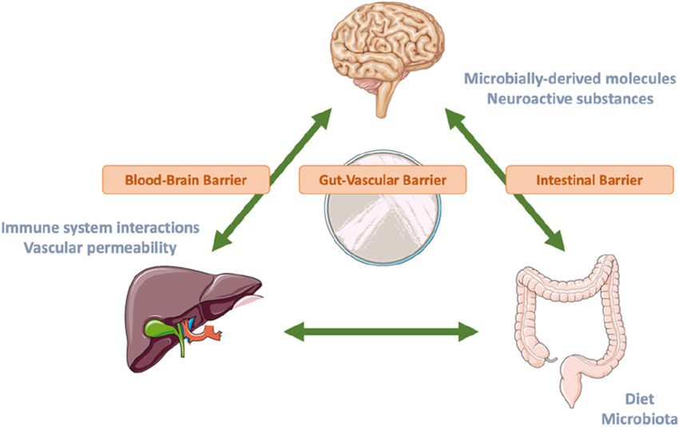
Brain/Gut/Liver Axis
Why focus on these three organs?
The gut-brain-liver axis involves complex interactions between three organs that play a vital role in metabolic health and increasingly draw scientific interest and research.
Over the last two decades, researchers have achieved significant progress in exploring gut-brain-liver communication by better understanding its development process and expanding therapeutic options.
The three pillars of the Metabolic Matrix are Support the Brain, Protect the Liver, and Feed the Gut.
Source: https://metabolicmatrix.info/gut-brain-liver-axis/
Source: Nutrition and the Gut-Liver-Brain Axis, Current Hepatology Reports.

Slide 17
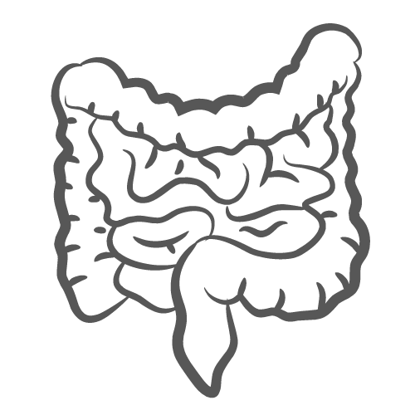
Feed the Gut
Feed the Gut
Reduce processed carbohydrates
Whole intact food (cellular) matrix
Provide prebiotic nourishment (Soluble fiber & Insoluble fiber)
Replace probiotic nourishment (gut microbiota)
Notes:
Digestion takes place inside the gastrointestinal tract.
Food that is eaten is broken down into individual macronutrients (protein, carbohydrates or fats) and micronutrients such as sodium, potassium, calcium, and vitamins.
The end result of the digestion process is individual molecules that are small enough that the nutrients can be absorbed.

Slide 18
Protect the Liver
Fructose reduction
Reduce total sugar intake
Appropriate hydration
Reduce environmental toxins
Reduce glycemic load

Slide 19
Support the Brain
Through nutrient-dense foods
With healthy and brain-essential fats
With healthy proteins providing sufficient and appropriate amino acids
With “brain-selective” nutrients which help govern neurotransmitter function

Slide 20
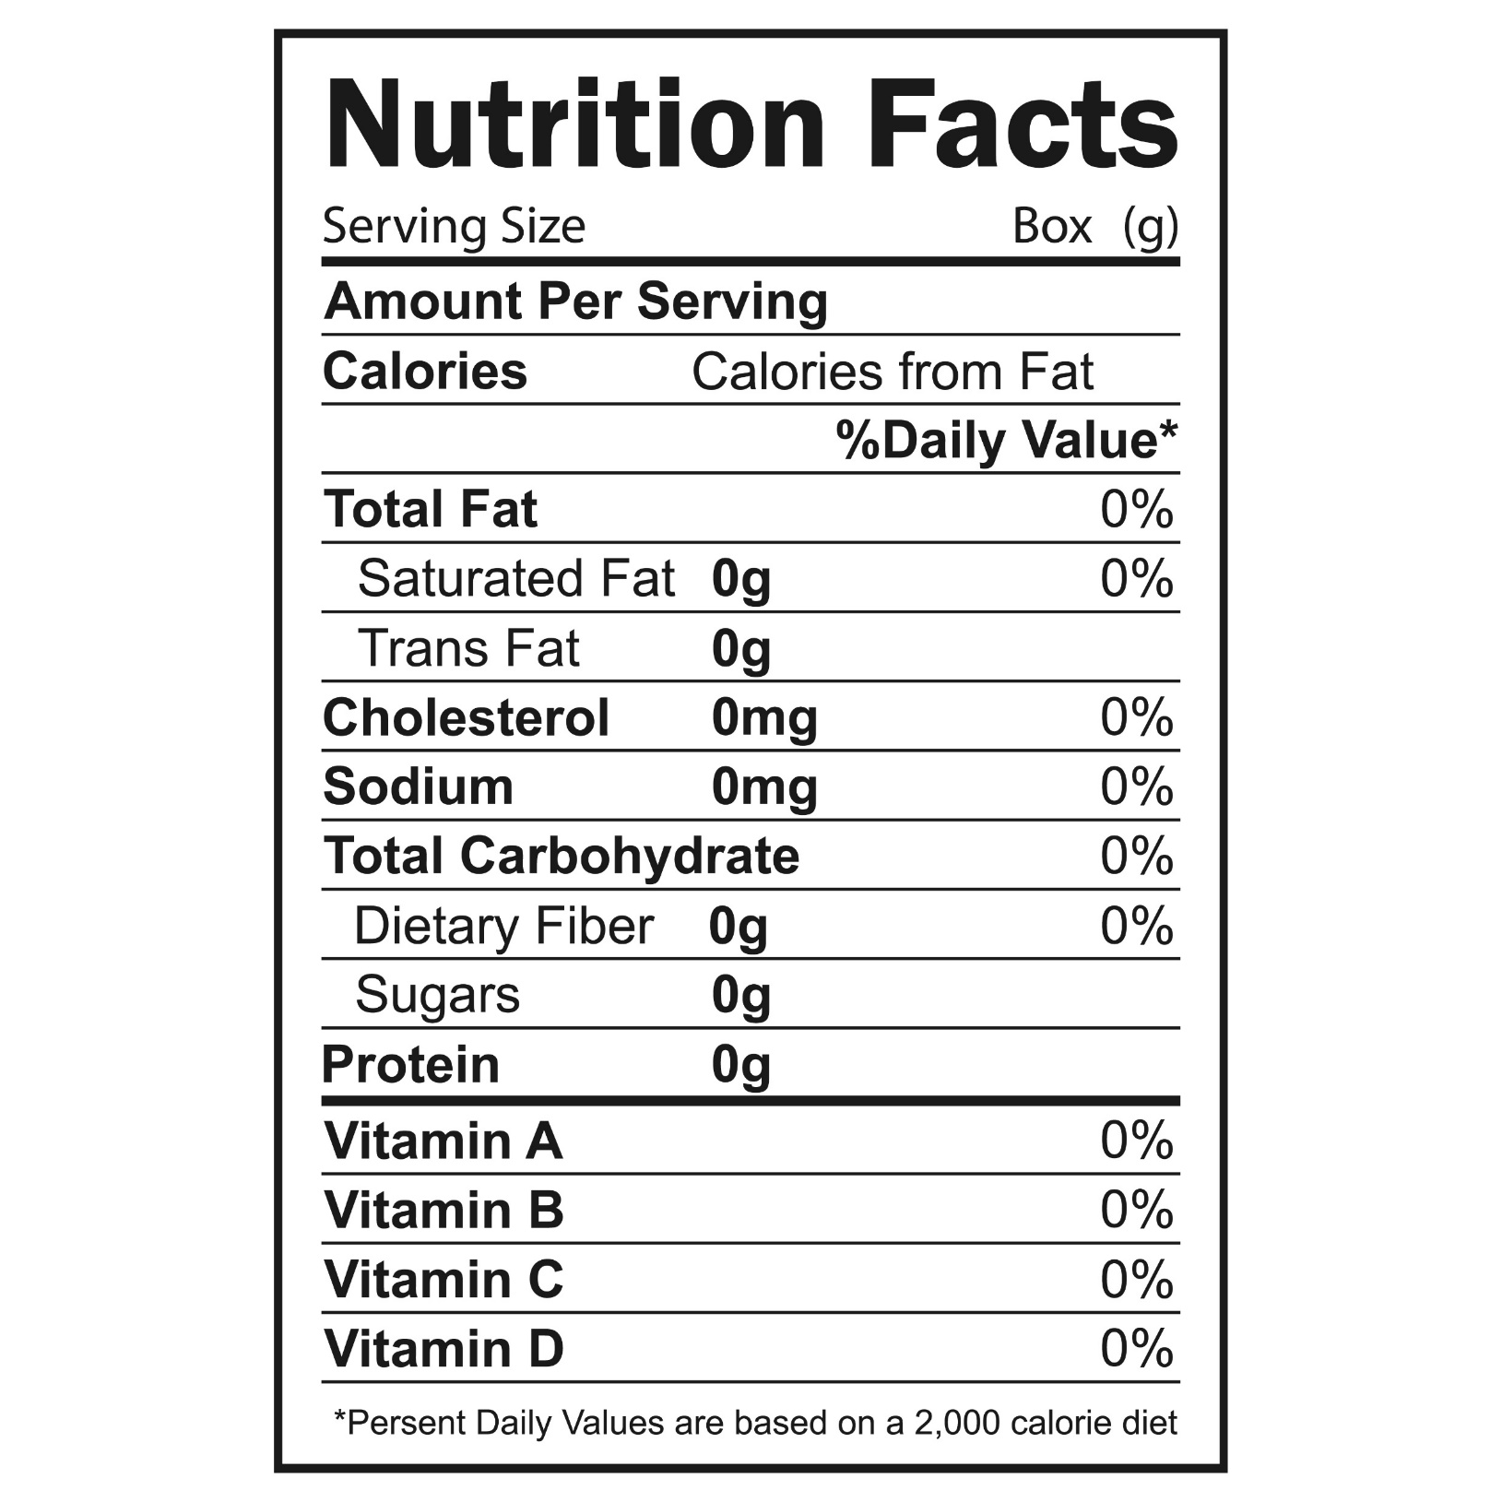
Metabolic Matrix is Powered by Advanced Data Science
Precision Data
Precision data tools can transform the food system, and the ways that consumers and industry interact.
KDD is pioneering the use of a state-of-the-art food data analysis and reporting.
Evidence based
Transparency at product, ingredient, component, or process levels
Structured & progressive criteria structed in “filters”
Filters available for unlimited evidence-based criteria
Provides recommendations & solutions
Scales to any size portfolio: food & beverage companies, health & education systems, national branded food databases.
KDD’s initial portfolio analysis included over 75,000 data points.
Examples of criteria:

Slide 21
Metabolic Matrix Methodology / Tiers
39 evidence-based criteria are organized into 5 progressive tiers
Details and evidence base shared in the peer reviewed methods paper in Frontiers of Nutrition are available at https://metabolicmatrix.info

Slide 22
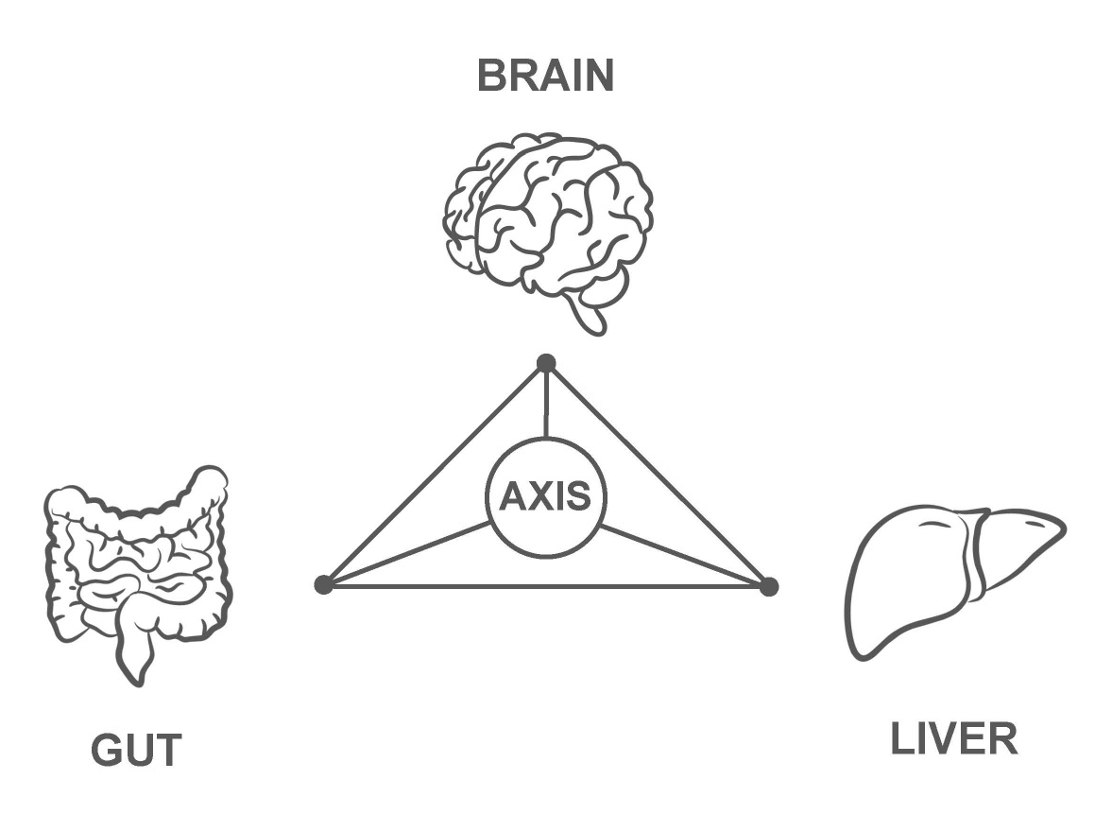
Ingredient that negatively affects all three organs of the Brain/Gut/Liver Axis in excess amounts: added sugar
Food Addiction
Affects on the Brain
Reduced cognitive function, increased cognitive impairment, food addiction
Decreased memory performance
Increased brain inflammation
Affects on the Gut
Lowers composition/functionality gut microbiota
Disruption of the intestinal barrier, and leaky gut
Irritable bowel syndrome
Affects on the Liver
Hepatic steatosis - NAFLD
Catalyzes other metabolic dysfunctions
Increased risk of liver cancer
Memory
Cognition
Inflammation
Microbiota
Fatty Liver Disease
Leaky Gut
Metabolic Dysfunction
IBS
Increased risk of liver cancer
Source: https://metabolicmatrix.info/gut-brain-liver-axis/

Slide 23
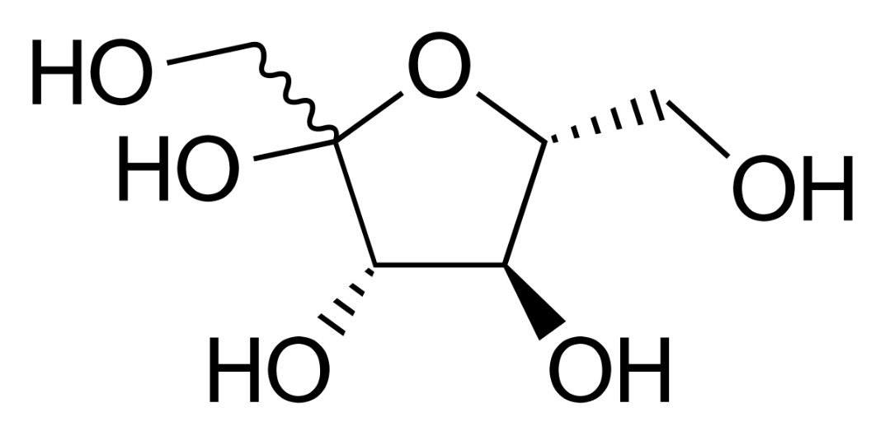
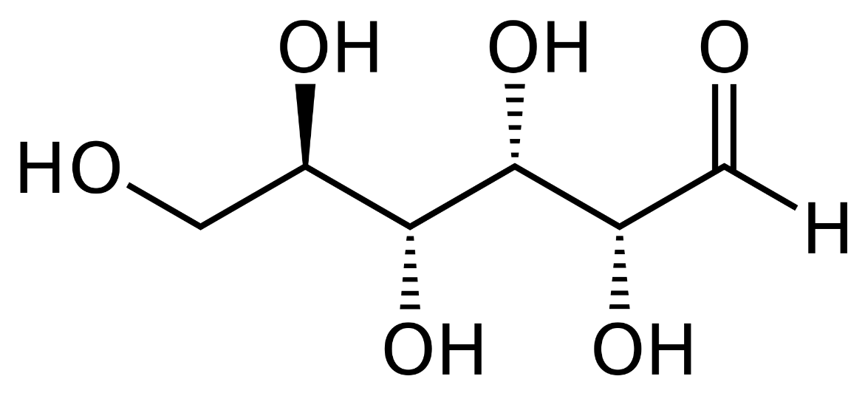
Tiers criteria that inform KDD no-added-sugar product development:
“no more than 2 grams of added fructose per serving”
“no more than 4 grams of added glucose per serving”
Most added sugar comes in the form of sucrose (50% fructose/50% glucose), so this basically means no more than one teaspoon (4 grams) of sugar per serving (100 grams).
Sucrose, glucose, and fructose are three common types of sugar that are metabolized differently and have different effects on the body.
We have no criteria for naturally occurring lactose in KDD dairy products as we do not see this a significant concern, as it is natural part of dairy, which is generally considered protective to type 2 diabetes.
Of course, it is important to avoid ANY excess of sugar in the diet. Daily consumption of sugar-rich products is alarmingly high in Kuwait, averaging over 25 kg* per year.
There is no dietary requirement for added sugar, so the preference is therefore “zero added sugar”.
The WHO recommends reducing the intake of free sugars to NO MORE THAN 5 to 10% of total energy intake.
Fructose
Glucose
Source: *Sugar consumption in Kuwait, Helgi Library.
Notes:
In its 2015 report on Carbohydrates and Health ⁽ ¹ ⁾, the UK Scientific Advisory Committee on Nutrition (SACN) recommended that a definition of ‘free sugars’ should be adopted in the UK for public health nutrition purposes, the concept replacing ‘non-milk extrinsic sugars’ on which sugar intake recommendations had been based for the last 25 years⁽ ² ⁾.
Free sugars as described by SACN: ‘All monosaccharides and disaccharides added to foods by the manufacturer, cook or consumer, plus sugars naturally present in honey, syrups and unsweetened fruit juices.
Under this definition, lactose (the sugar in milk) when naturally present in milk and milk products and the sugars contained within the cellular structure of foods are excluded’.
(A definition of free sugars for the UK - https://www.ncbi.nlm.nih.gov/pmc/articles/PMC5962881/)
Sugar consumption per capita reached 25.9 kg in 2021 in Kuwait, according to Faostat. This is 13.7% less than in the previous year.
Historically, sugar consumption per capita in Kuwait reached an all time high of 41.4 kg in 2003 and an all time low of 21.5 kg in 1991.
Kuwait has been ranked 77th within the group of 165 countries we follow in terms of sugar consumption per capita.
Nearly 70 percent of added sugars intake comes from 5 food categories: sweetened beverages, desserts and sweet snacks, coffee and tea (with their additions), candy and sugars, and breakfast cereals and bars. Evidence suggests that adverse effects of added sugars, particularly from SSB, may contribute to unhealthy weight gain and obesity-related health outcomes. Reducing the amount of added sugars in the diet, either through changes in consumer behavior or in how food is produced and sold, is an achievable objective that could improve population health. After considering the scientific evidence for the potential health impacts of added sugars intake, along with findings from model-based estimations of energy available in the dietary pattern after meeting nutrient requirements, the Committee suggests that less than 6 percent of energy from added sugars is more consistent with a dietary pattern that is nutritionally adequate while avoiding excess energy intake from added sugars than is a pattern with less than 10 percent energy from added sugars.
Source: https://www.dietaryguidelines.gov/sites/default/files/2020-07/ScientificReport_of_the_2020DietaryGuidelinesAdvisoryCommittee_first-print.pdf

Slide 24
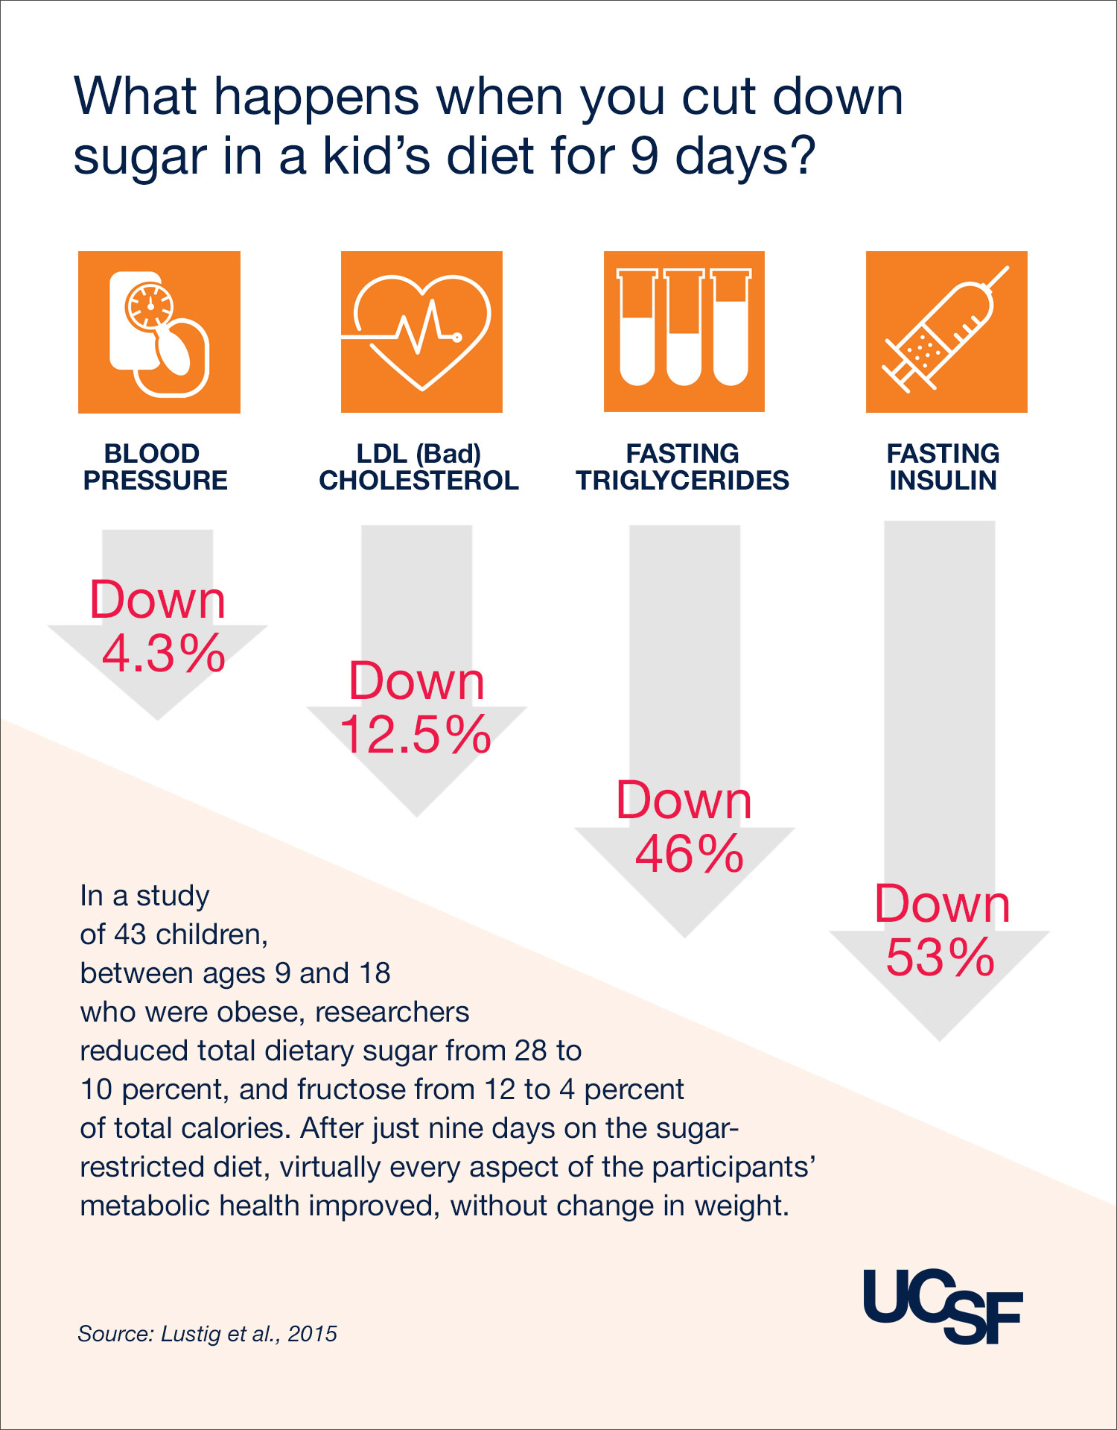
Why prioritize fructose reduction?
Glucose is metabolized by every cell in the body.
Fructose is metabolized primarily in the liver.
Fructose restriction can have multiple metabolic benefits in relatively short period of time.
Nonalcoholic Liver Disease (NAFLD) is prevalent in over one-third of Kuwaitis.
Nonalcoholic steatohepatitis (NASH) currently consumes nearly 8% of the Kuwait national healthcare budget.
Dr. Robert H. Lustig, KDD’s lead scientific advisory, is a global expert on dietary fructose and fructose metabolism.
The no-added-sugar ice cream developed by KDD has less than .112g per 100g fructose, a negligible amount.
Fructose restriction study showed multiple metabolic benefits in just 9 days (without calorie restriction).
Source: Available at https://robertlustig.com/fructose-restriction/
Notes:
Hepatol Int. 2021 Aug; 15(4): 912–921.
Published online 2021 Apr 6. doi: 10.1007/s12072-021-10182-x
PMCID: PMC8382637
PMID: 33822317
Clinical and economic burden of nonalcoholic steatohepatitis in Saudi Arabia, United Arab Emirates and Kuwait
NAFLD prevalence in the ME is 32% [8], one of the highest worldwide, although there are limited data for individual countries. Available reports suggest at least a third of the Kuwaiti, UAE and KSA population suffer from NAFLD (33.3% [19], 34.7% [25] and ≤ 52% [26, 27], respectively).
https://www.ncbi.nlm.nih.gov/pmc/articles/PMC8382637/
NAFLD prevalence in the Middle East is 32%, one of the highest worldwide. Research shows a third of the Kuwaiti, UAE and KSA population suffer from NAFLD (33.3% , 34.7% and ≤ 52%, respectively).
Similar trends occurred in UAE and Kuwait. Discounted lifetime costs of NASH standard-care increased totaling USD40.41 bn, 1.59 bn and 6.36 bnin KSA, UAE (Emiratis only) and Kuwait, respectively. NASH-related costs in 2019 comprised, respectively, 5.83%, 5.80%and 7.66% of national healthcare spending (2) (PDF) Clinical and economic burden of nonalcoholic steatohepatitis in Saudi Arabia, United Arab Emirates and Kuwait. Available from: https://www.researchgate.net/publication/350669030_Clinical_and_economic_burden_of_nonalcoholic_steatohepatitis_in_Saudi_Arabia_United_Arab_Emirates_and_Kuwait#fullTextFileContent [accessed May 30 2024].
https://robertlustig.com/fructose-restriction/

Slide 25
Technical Versus Ethical “No Added Sugar”
Real Versus Fake No-Added-Sugar Claims
Some manufacturers are claiming “no added sugar” which may be technically correct, but adding fruit juice as a proxy for added sugar is not forthcoming and can mislead consumers who may be seeking to reduce dietary sugars for important health reasons.
?

Slide 26
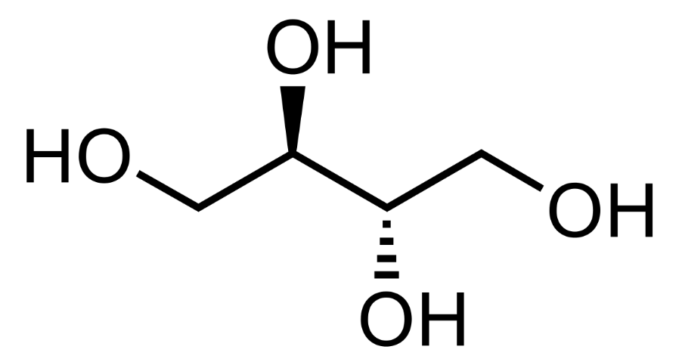
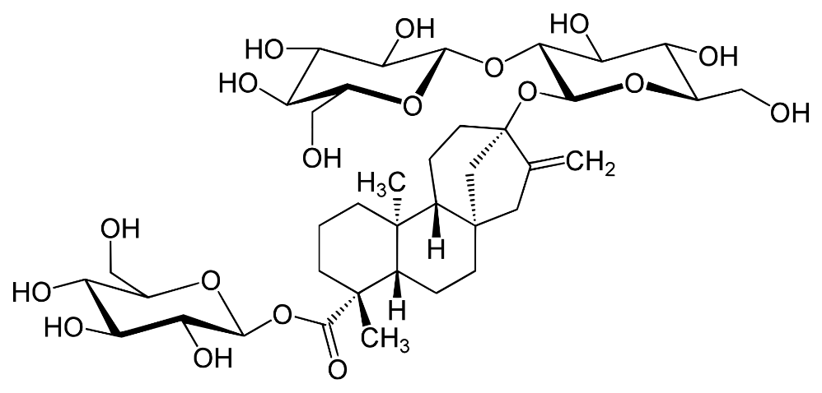
Safe & Effective Sweetener Solutions
One of the key deliverables of the research supported by KFAS was to thoroughly investigate alternatives to sugar.
Reengineering foods without sugar is not simple.
KDD seeks a genuine reduction in total sugar, reviewing the scientific literature and carefully evaluating the safest and most effective sweetener solutions available.
We determined that Erythritol and Stevia are optimal solutions, given what the GSO currently allows.
References here:
https://metabolicmatrix.info/scientific-evidence/
(Erythritol)
(Steviol glycoside)
Notes:
monk fruit juice concentrate at 0.885% in NAS chocolate ice cream. This means that we have 0.112 g /100g fructose

Slide 27
Ingredient that positively affects all three pillars of the metabolic matrix: Chocolate
Mood & Sleep
Brain
Flavonoids improve cognitive function and protect against neurodegenerative diseases
Phenylethylamine and tryptophan can enhance mood & sleep
Increased cerebral flow
Gut
Improved diversity and abundance of gut bacteria
Decreased intestinal permeability
Improved mental health through the mind gut connection
Liver
Polyphenols slow the progression of liver disease
antioxidant, cardiovascular, & anti-inflammatory properties
Reduce risk for diabetes and insulin resistance
Cognition Function
Cerebral Flow
Microbiota Health
Resist Diabetes and Insulin Resistance
Intestinal Barrier Improved
Resist Disease Progression
Mental Health
Antioxidant and Anti-inflammatory Benefits
https://metabolicmatrix.info/gut-brain-liver-axis/
Notes:
Cocoa and Chocolate in Human Health and Disease, https://www.ncbi.nlm.nih.gov/pmc/articles/PMC4696435/

Slide 28
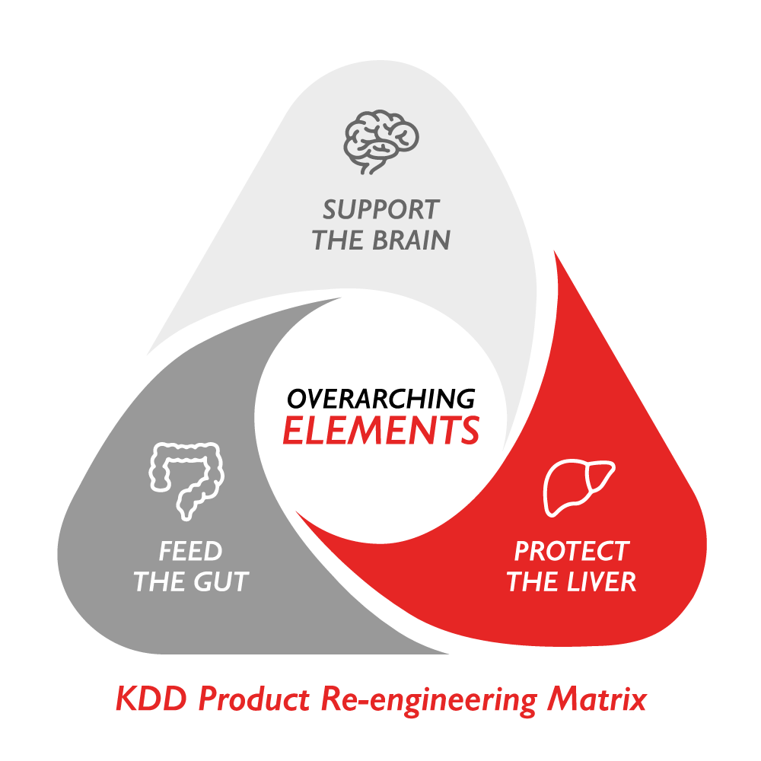
What’s Next?
More collaborative scientific studies and projects.
Updates to the Metabolic Matrix as the Science evolves.
Scaling and replicating of the Metabolic Matrix.
Accelerating innovations such as novel functional ingredient solutions.
Collaborations with Sustainability and Nutrition Partners.
Development of Continuing Medical Education and other public health learning opportunities.
Active consultation with the nutrition and health community in Kuwait.
We are listening – Please engage with us!

Slide 29
Your wish is our command. A whole generation of new Good For Me products that support the brain, protect the liver, and feed the gut.
Notes:
“Haather”, which means “your wish is my command” or “you bet”

Slide 30
Thank you!

