Slide 1
Research & Development Partnership
12th June 2024, Dasman Diabetes Institute

Slide 2
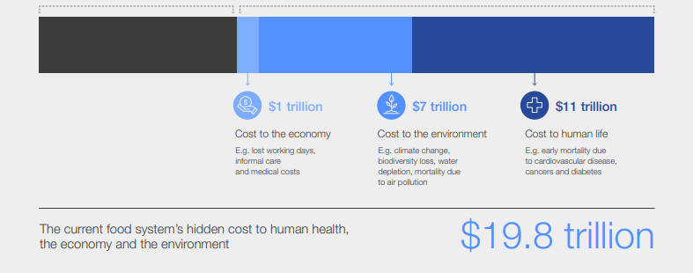
THE CURRENT FOOD SYSTEM’S COST IMPACT IS HUGE.
9 trillion USD is the cost of global food consumption.
19.8 trillion USD is the hidden cost of current dietary patterns.
The current food system’s hidden cost to human health, the economy and the environment is more than double the cost of global food consumption.
However, a recent study from the Global Food System Economics Commission shows that the net benefits of achieving a food system transformation are worth 5 to 10 trillion USD/year. There is a positive impact that can be made.
Source : https://metabolicmatrix.info/

Slide 3
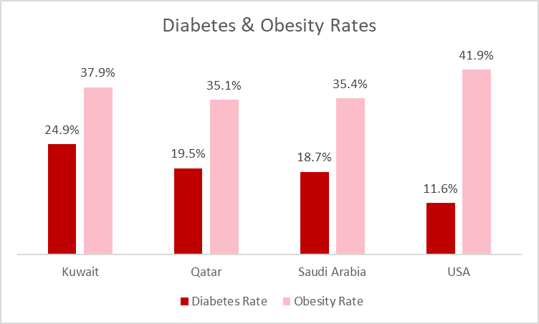
THE ADVERSE HEALTH IMPACT IN THE GCC IS EQUALLY ALARMING
Over consumption of sugar is strongly linked with Diabetes and Obesity.
​
High consumption in the Middle East with an average intake of 85g per day.
Direct & indirect costs of total non-communicable disease expenses in 2019 was 47.2 billion USD.
WHO recommends reducing the intake of free sugars in adults and children to less than 10% of total energy intake, optimally to less than 5% or 25g per day.
Source : https://www.ncbi.nlm.nih.gov/pmc/articles/PMC9149705/
Source : cdc website

Slide 4
THE PROBLEM EXTENDS BEYOND DIABETES & OBESITY

Slide 5
SUGAR REDUCTION JOURNEY AT KDD
PRE 2017
JANUARY
2017
JUNE
2019
TILL DATE
KDD initiates sugar reduction draft for ice cream.
PAFN meets with local food manufacturers on salt & sugar reduction initiatives within their portfolio.
KDD implements initiatives in nectars and drinks.
KDD drafts a sugar reduction policy for all KDD products.
Further sugar reductions achieved.
Vanilla soft ice : 5% reduction
Strawberry flavoured milk : 5% reduction
Banana flavoured milk : 5% reduction
Prototype developed for Frozen Yoghurt at 65% sugar reduction.

Slide 6
DRAFTING & DEPLOYING THE METABOLIC MATRIX
THE FOUNDATION IN 2020
CREATION IN 2021
DEPLOYMENT BEGINS IN 2022
KDD begins the journey to rethink packaged foods and beverages.
From farm-to-fork thinking to a farm-to-cell approach. It is about what ingredients do inside of your body.
KDD creates the Metabolic Matrix, an evidence-based methodology to optimize food and beverage portfolios.
The 3 three key pillars are:
support the brain
protect the liver
feed the gut.
KDD implements the Metabolic Matrix guidance in new product developments.
In 2024, after two years of rigorous development, testing, and a clinical trial, KDD introduces products optimized for metabolic benefits.

Slide 7
THE GUIDING FRAMEWORK IN EVERYTHING WE DO.
SUSTAINABILITY FRAMEWORK
PEOPLE
PLANET
NUTRITION
METABOLIC MATRIX
PARTNERSHIP WITH KEY STAKEHOLDERS
NEW PIPELINE OF PRODUCTS

Slide 8
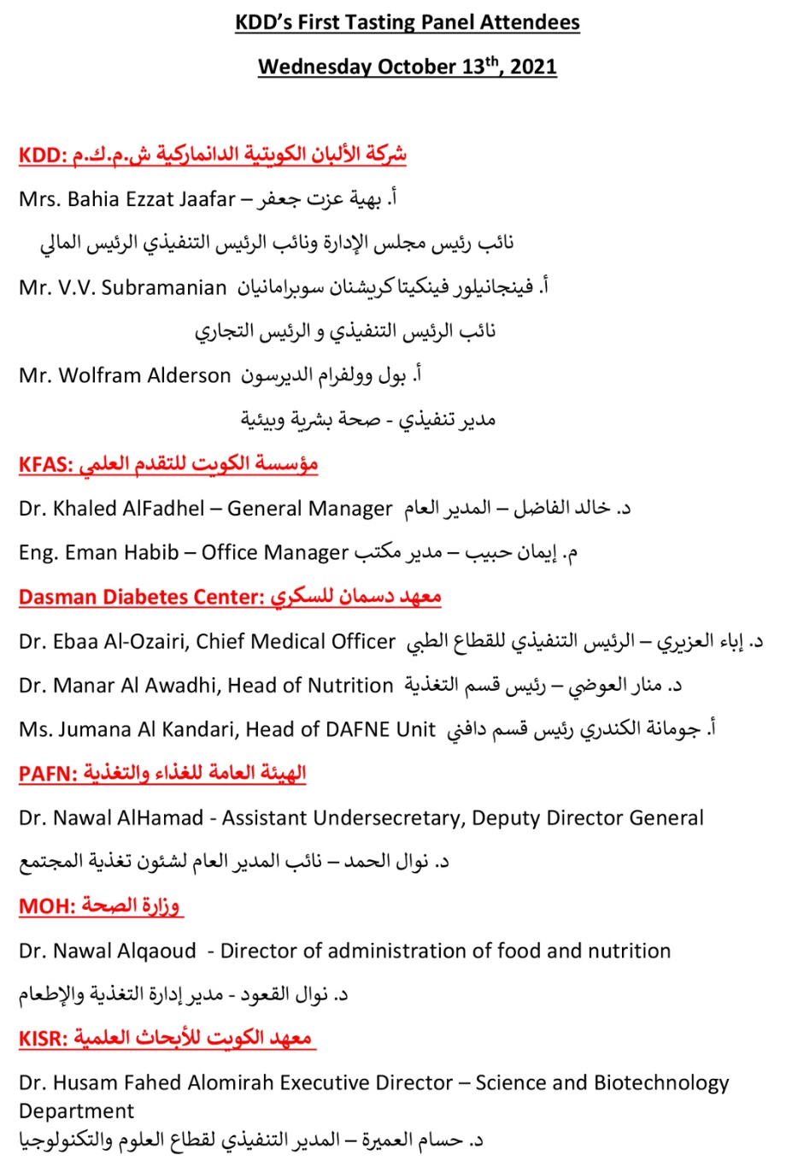
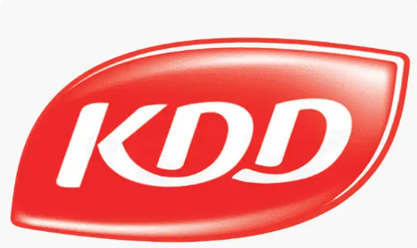
TWO TASTING PANELS WERE CONDUCTED WITH KEY STAKEHOLDERS

Slide 9
CONFIDENT IN OUR PROGRESS, WE MOVED TO NEXT STEPS
FEBRUARY 9,
2022
AUGUST 7,
2022
OCTOBER 2022 TO AUGUST 2023
KDD signs NDA with Dasman Diabetes Institute.
KDD signs acceptance letter with KFAS for the project “DEVELOPMENT OF A NEW RANGE OF NO ADDED SUGAR PRODUCTS”
DDI conducts clinical trials for no added sugar chocolate ice cream prototypes.

Slide 10
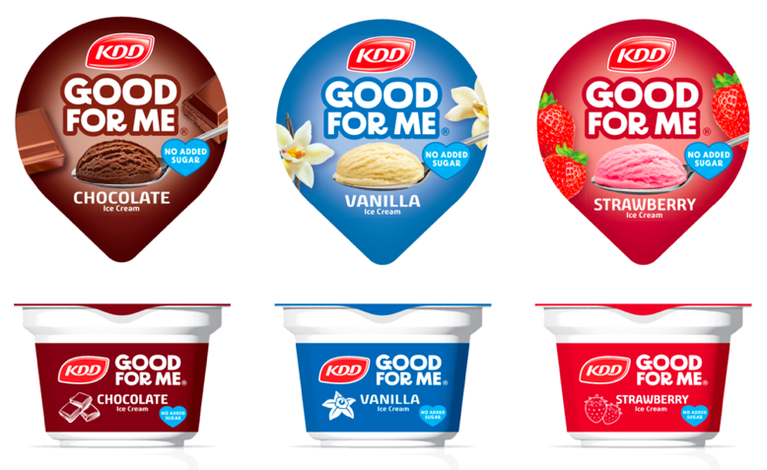
INTRODUCING GOOD FOR ME BY KDD!
No added sugars.
Rich taste & texture.
Improves insulin response.

Slide 11
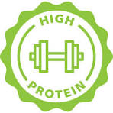
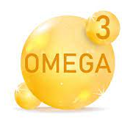
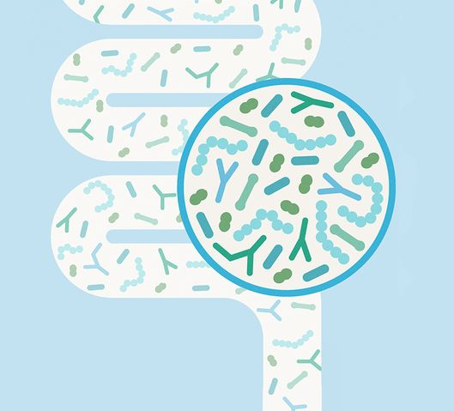
MORE TO COME IN 2024 & BEYOND…
The following platforms will be on focus in our product development.
High protein
Fiber addition
Omega 3 inclusion
Healthy microbiome
To be made available as ready to eat, ready to drink and spoonable formats.

Slide 12
THANK YOU

